Slide 1
MEDB 5510 Clinical Research Methods
Week 7 – Part 2
Sampling & External Validity
Notes:
Homework

Slide 2
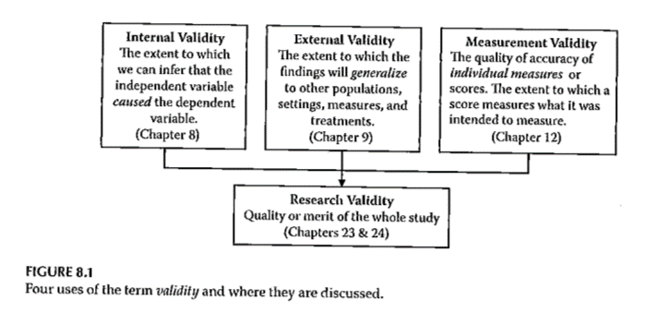
Validity

Slide 3
Sampling
“… process of selecting part of a larger group of participants with the intent of generalizing from the sample (the smaller group) to the population (the larger group).”
“… representativeness of the sample is more important than its size …”

Slide 4
Sampling
Reasons for sampling
Expense
Time
Quality control

Slide 5
Sampling

Slide 6
Sampling
Sampling designs – Probability sampling
Simple random sampling
Systematic random sampling
Stratified random sampling
Cluster (random) sampling

Slide 7
Sampling
Sampling designs – Nonprobability sampling
Quota sampling
Purposive sampling
Purposeful sampling
Convenience sampling

Slide 8
Sampling
Sample size
General rules
Representativeness vs number
Impact of having very large sample sizes
Generally –
Need sample to be large enough so you don’t miss important findings
If very large sample, need to distinguish statistical significance vs clinically important

Slide 9
External Validity
Generalizability
Fig. 9.3
Evaluating Research Validity Framework
Two main aspects
Population external validity
Ecological external validity

Slide 10
External Validity
Population external validity
How participants were selected for the study?
Is sample representative of the target population?
Validity framework

Slide 11
External Validity
Ecological external validity
Whether the results can be generalized to real-life outcomes
Trade-off with control of study
Validity framework

Slide 12
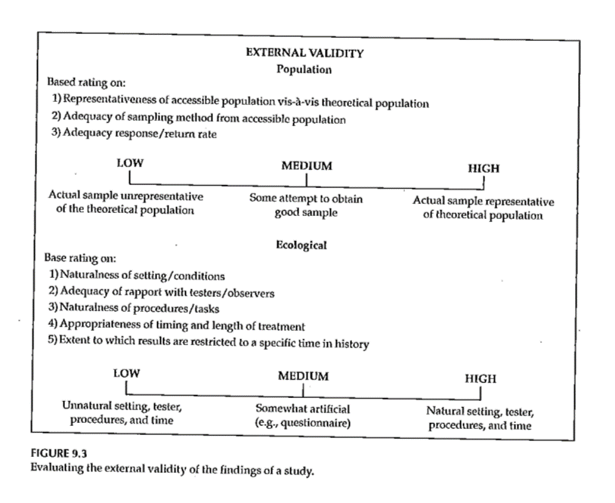
External Validity

Slide 13
Sampling and Validity

Slide 14
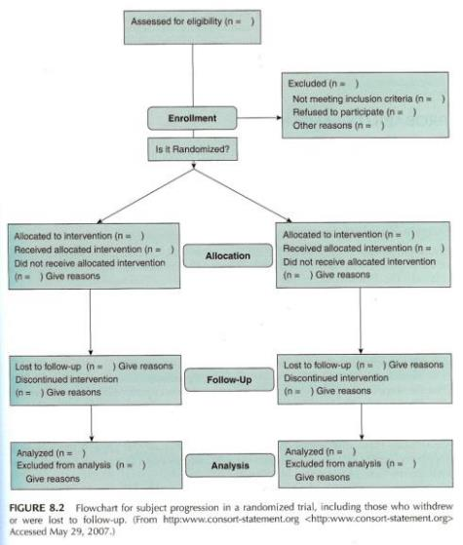
Sampling
Portney & Watkins (2009)
14

Slide 15
Assignment #5
Prepare a first draft of the literature review that supports your research topic and provides evidence of the significance of the topic. Submit this assignment using “Turnitin” through Blackboard.

